Slide 1
Generating all possible captions

Slide 2
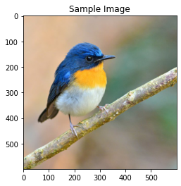
a white bird sitting on top of a branch .
a white bird sitting on top of a tree branch .
a white bird sitting on top of a wooden table .
a small bird sitting on a branch in a tree .
a small bird is perched on a branch

Slide 3
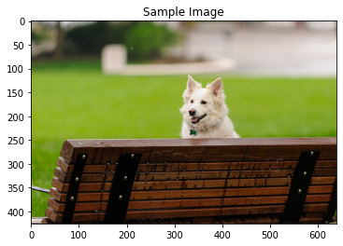
a cat sitting on top of a wooden bench .
a cat that is sitting on a bench .
a cat that is sitting on a wooden bench .
a dog is sitting on a chair with a frisbee .
a dog is sitting on a bench in a garden .
a dog is sitting on a bench in front of a window .
a dog is sitting on a bench in front of a door .
a dog is sitting on a bench with a frisbee .
a dog that is sitting on a chair .
a dog that is sitting on a bench .

Slide 4
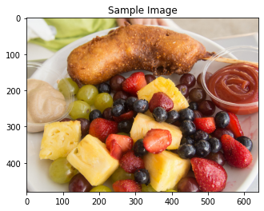
a plate of food with meat and vegetables .

Slide 5
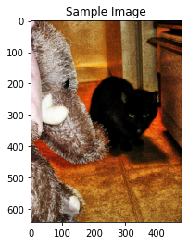
a cat sitting on top of a couch next to a remote control .
a cat sitting on top of a couch next to a cat .
a cat sitting on top of a couch with a remote control .

Slide 6
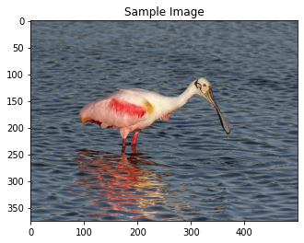
a bird is standing on the beach by the water .
a bird is standing on the beach looking at the water .
a bird is standing on the edge of a body of water .
a bird is standing on the edge of a tree .
a bird is standing on the edge of a beach .
a bird standing on the beach looking at the water .
a bird standing on the beach near a body of water .
a bird standing on the beach by a body of water .
a bird standing on the edge of a body of water .
a bird standing on top of a sandy beach .

Slide 7
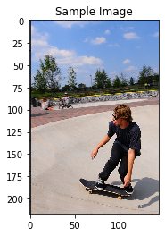
a man riding a skateboard on top of a cement block .
a man riding a skateboard up the side of a ramp .

Slide 8
Generating all possible captions on Super images

Slide 9
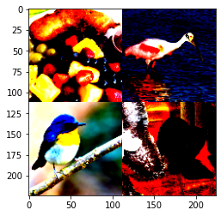
a white plate with a piece of cake and a fork .
a plate of food with a fork and knife .
a plate of food with a fork and knife
a couple of birds sitting on top of a table .

Slide 10
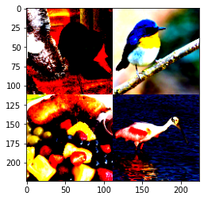
a group of birds sitting on top of a table .
a small bird sitting on top of a table .
a close up of a plate of food with a fork .

Slide 11
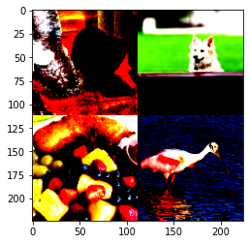
a dog is sitting on a couch with a plate of food .
a dog is sitting on a couch with a blue blanket .
a dog is sitting on a couch with a blue cloth .
a dog is sitting on a couch with a blue tablecloth .
a dog laying on top of a couch next to a table .
a dog laying on top of a couch next to a pile of books .

Slide 12
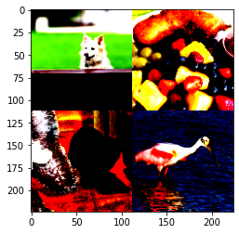
a cat sitting on top of a table next to a cup of coffee .
a cat sitting on top of a table next to a stuffed animal .
a cat sitting on top of a table next to a pile of food .
a cat sitting on top of a table next to a pile of green apples .
a cat sitting on top of a table next to a pile of apples .
a cat that is sitting on a table .
a small dog sitting on a table with a plate of food .
a small dog sitting on a table with a plate of food
a dog sitting on a table with a plate of food .
a dog sitting on a table with a plate of food .
a dog sitting on a table in front of a plate of food .
a dog sitting on a table in front of a bowl of food .
a dog sitting on a couch with a plate of food .
a dog sitting on a couch with a plate of food .
a dog sitting on a couch with a blue plate .
a dog sitting on a couch with a blue blanket .
a dog sitting on a couch with a blue frisbee .
a dog that is sitting on a table .
a dog that is sitting on a couch .

